Slide 1
Reinforcement Learning
Ying shen
Sse, tongji university
Jul. 2024
Notes:
https://people.stfx.ca/jdelamer/courses/csci-531/index.html

Slide 2
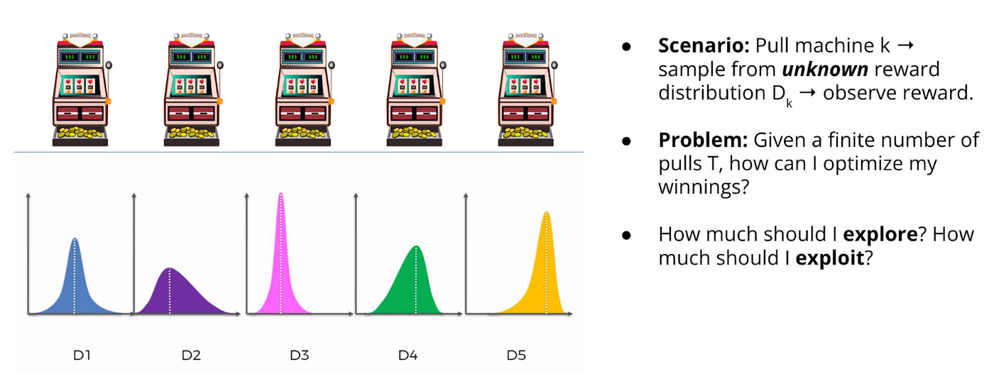
K-Armed Bandit Problem
The K-armed bandit problem (also known as the multi-armed bandit problem) is a simple, yet powerful example of allocation of a limited set of resources over time and under uncertainty.
It has been initially studied by Thompson (1933), who suggested a heuristic for navigating the exploration-exploitation dilemma.
Notes:
The problem has also been studied in the fields of computer science, operations research, probability theory, and economics, and is well suited for exploring with the tools of reinforcement learning.
In its basic form, the problem considers a gambler standing in front of a row of K slot machines (also known as one-armed bandits) and trying to conceive a strategy for which machine to play, for how many times, and when to switch machines in order to increase the chances of making a profit. What makes this premise interesting is that each of the bandits dispenses rewards according to a probability distribution, which is specific to the bandit and is initially unknown to the gambler. The optimal strategy, therefore, would involve striking a balance between learning more about the individual probability distributions (exploration) and maximising the profits based on the information acquired so far (exploitation). https://domino.ai/blog/k-armed-bandit-problem
https://people.stfx.ca/jdelamer/courses/csci-531/topics/intro/intro.html

Slide 3
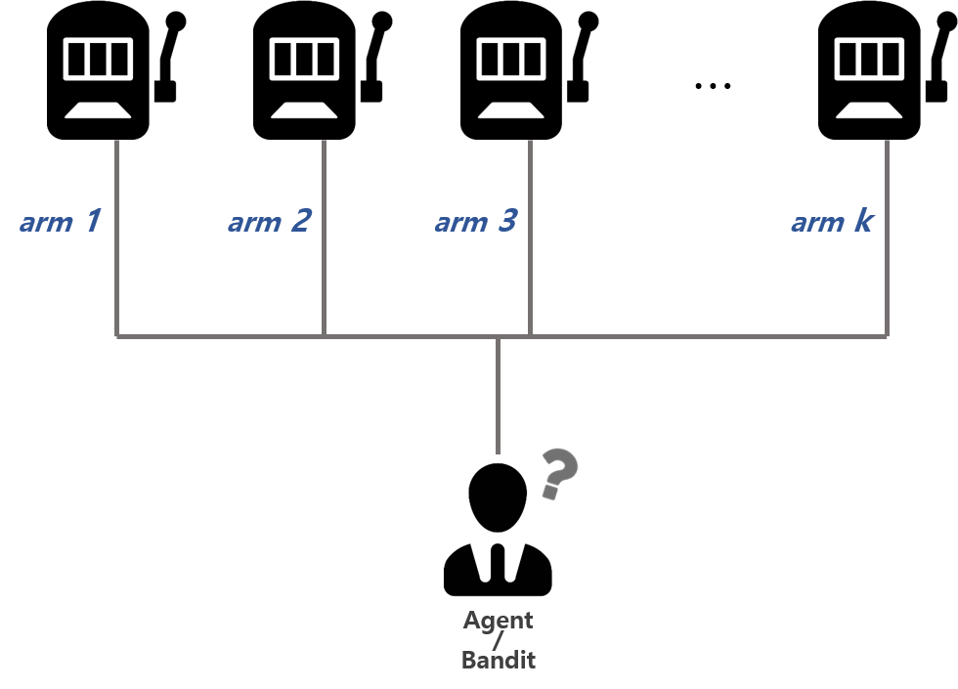
K-Armed Bandit Problem

Slide 4
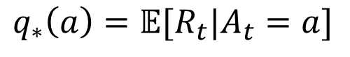
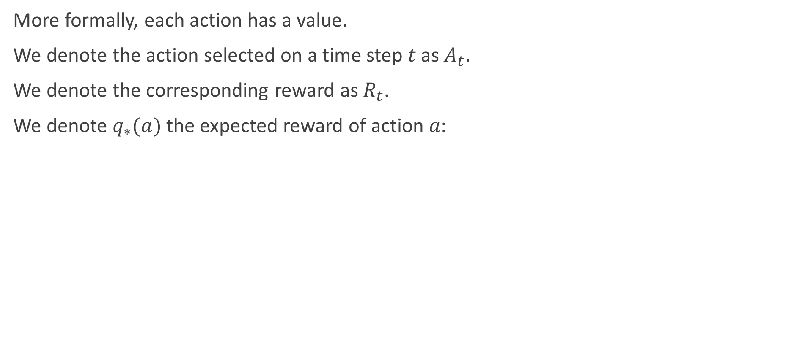
K-Armed Bandit Problem
More formally, each action has a value.
We denote the action selected on a time step 𝑡 as $A_{t}$.
We denote the corresponding reward as $R_{t}$.
We denote $q_{∗}(a)$ the expected reward of action 𝑎:
$$q_{∗}\left(a\right)=𝔼[R_{t}|A_{t}=a]$$

Slide 5
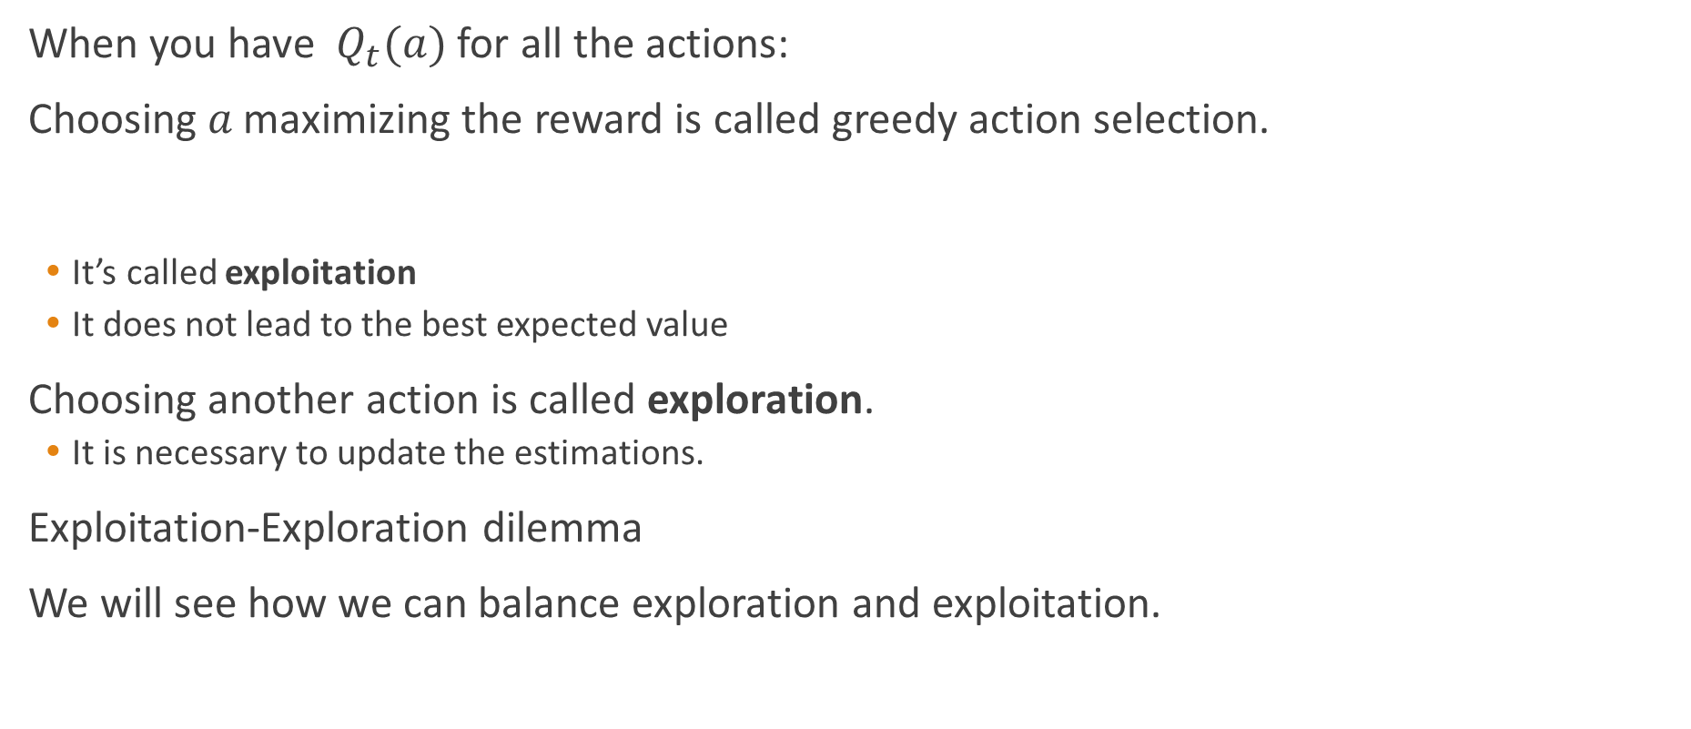
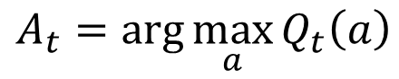
K-Armed Bandit Problem
When you have $Q_{t}(a)$ for all the actions:
Choosing 𝑎 maximizing the reward is called greedy action selection.
It’s called exploitation
It does not lead to the best expected value
Choosing another action is called exploration.
It is necessary to update the estimations.
Exploitation-Exploration dilemma
We will see how we can balance exploration and exploitation.
$$A_{t}=\arg{\max_{a}{Q_{t}\left(a\right)}}$$
Notes:
探索和利用这两者是矛盾的，因为尝试次数有限，加强一方则会自然削弱另一方，这就是强化学习面临的探索利用窘境。显然，欲累计奖励最大，则必须在探索与利用直接达成较好的折中。

Slide 6
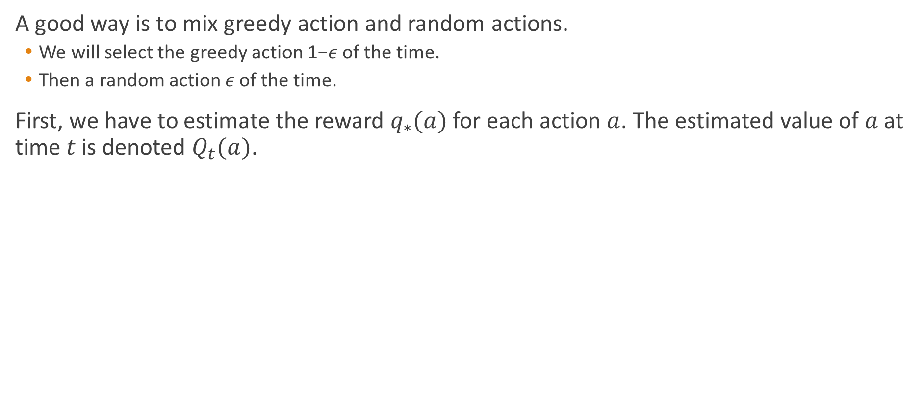
Action-value method
A good way is to mix greedy action and random actions.
We will select the greedy action 1−𝜖 of the time.
Then a random action 𝜖 of the time.
First, we have to estimate the reward $q_{∗}(a)$for each action $a$. The estimated value of 𝑎 at time 𝑡 is denoted $Q_{t}(a)$.
$$Q_{t}\left(a\right)=\frac{\text{sum} \text{of} \text{rewards} \text{when} a \text{taken} \text{prior} \text{to} t}{\text{number} \text{of} \text{times} a \text{taken} \text{prior} \text{to} t}=\frac{\sum_{i=1}^{t−1}{R_{i}⋅𝕀(A_{i}=a)}}{\sum_{i=1}^{t−1}{𝕀(A_{i}=a)}}$$
Notes:
$ε$贪心算法基于一个概率来对探索和利用进行折中：每次尝试时，以$ε$的概率进行探索，即以均匀概率随机选取一个摇臂；以$1−ε$的概率进行利用，即选择当前平均奖励最高的摇臂（若有多个，则随机选取一个）

Slide 7
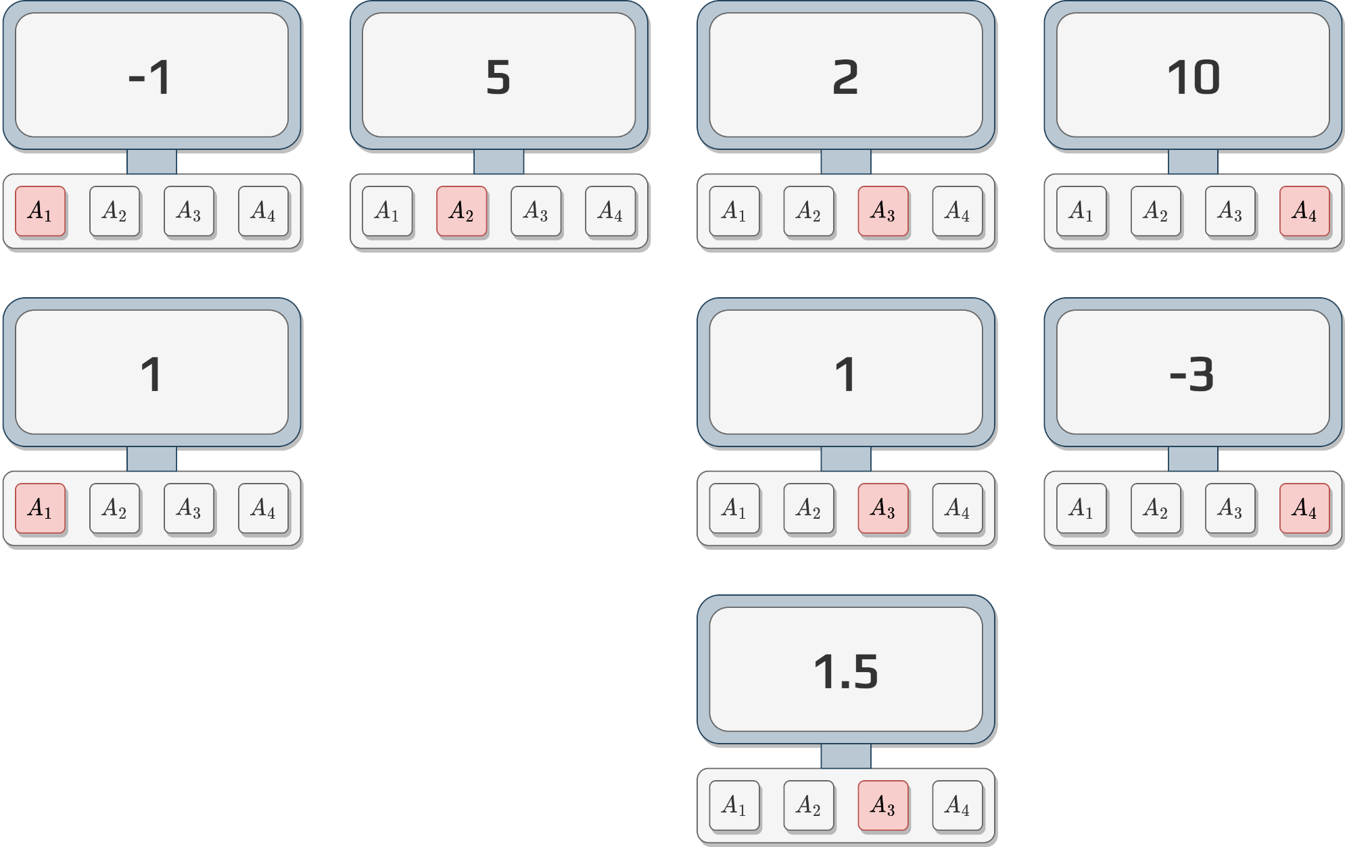
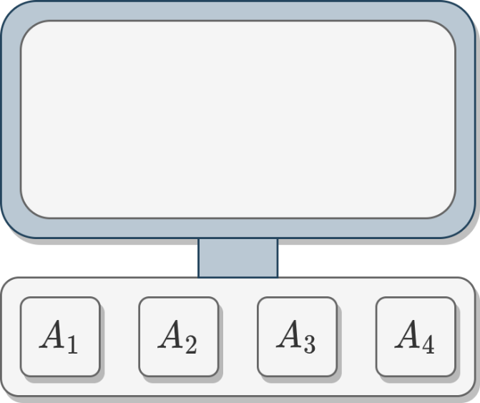
Action-value method
Let us simulate a few actions and results:

Slide 8
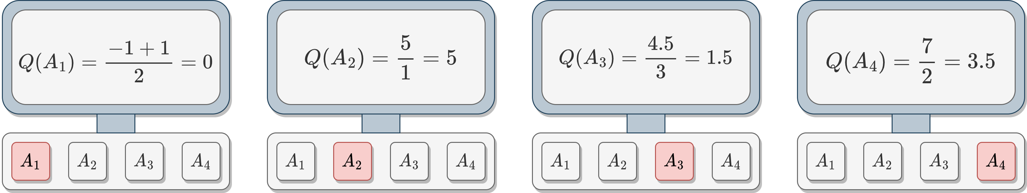
Action-value method
Based on these results:
Decide which button (action) you would push
Justify why
If we take back the previous activity and calculate the 𝑄-values we obtain the following:

Slide 9
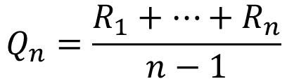
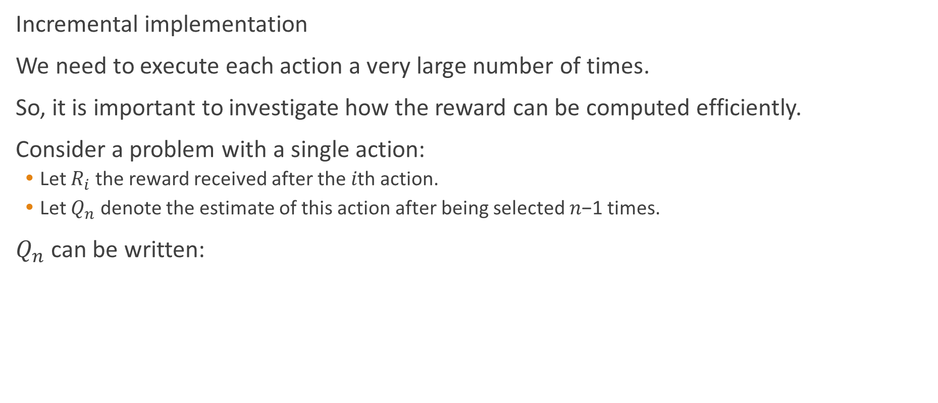
Action-value method
Incremental implementation
We need to execute each action a very large number of times.
So, it is important to investigate how the reward can be computed efficiently.
Consider a problem with a single action:
Let $R_{i}$ the reward received after the 𝑖th action.
Let $Q_{n}$ denote the estimate of this action after being selected 𝑛−1 times.
$Q_{n}$ can be written:
$$Q_{n}=\frac{R_{1}+⋯+R_{n}}{n−1}$$

Slide 10
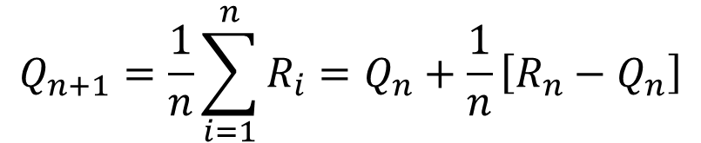
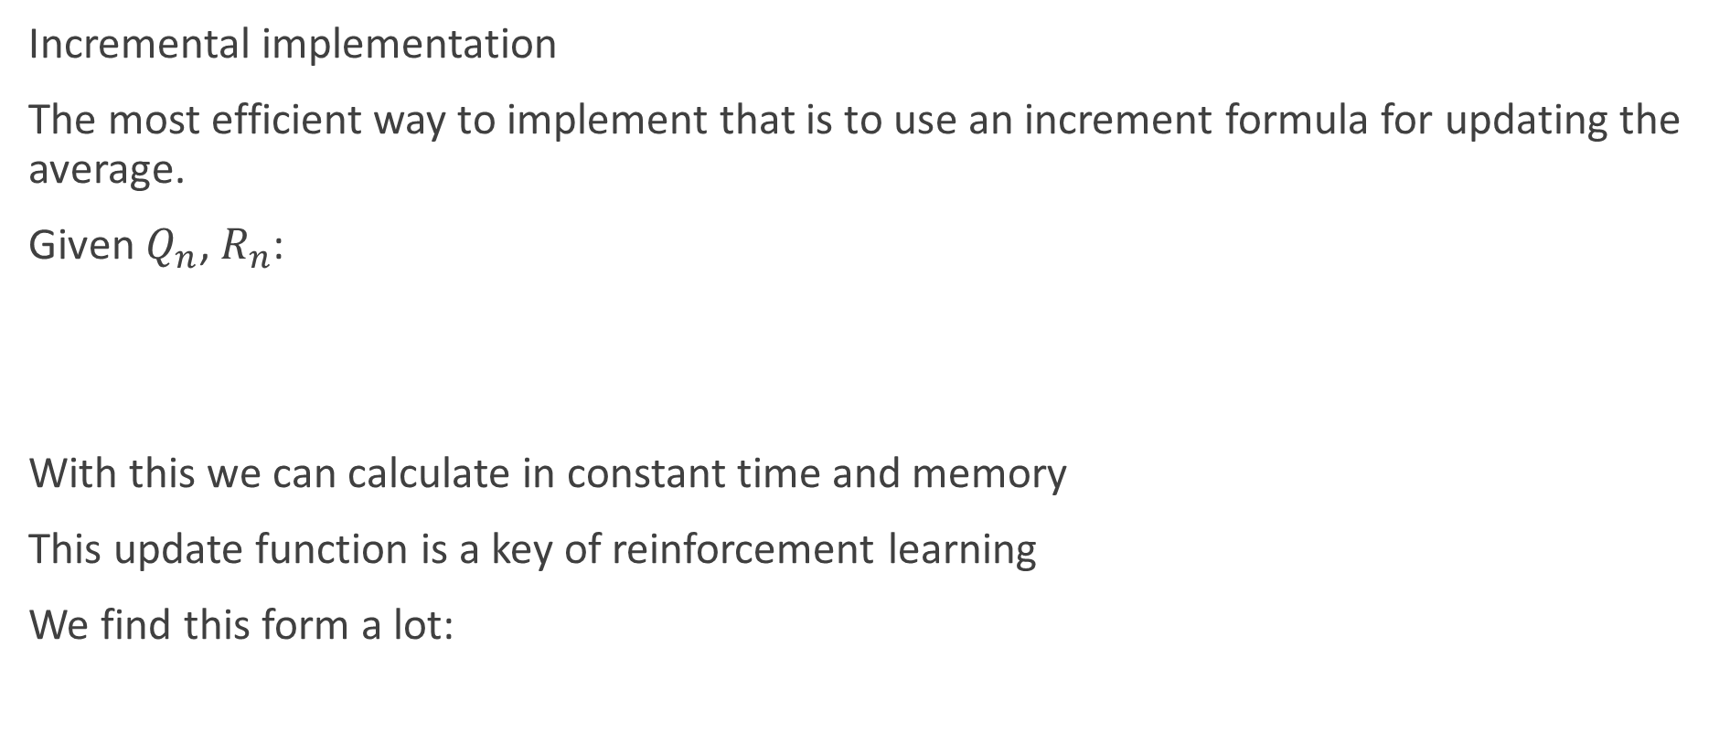
Action-value method
Incremental implementation
The most efficient way to implement that is to use an increment formula for updating the average.
Given $Q_{n}$, $R_{n}$:
With this we can calculate in constant time and memory
This update function is a key of reinforcement learning
We find this form a lot:
$$Q_{n+1}=\frac{1}{n}\sum_{i=1}^{n}{R_{i}}=Q_{n}+\frac{1}{n}\left[R_{n}−Q_{n}\right]$$
$$NewEstimate←OldEstimate+StepSize\left[Target−OldEstimate\right]$$

Slide 11
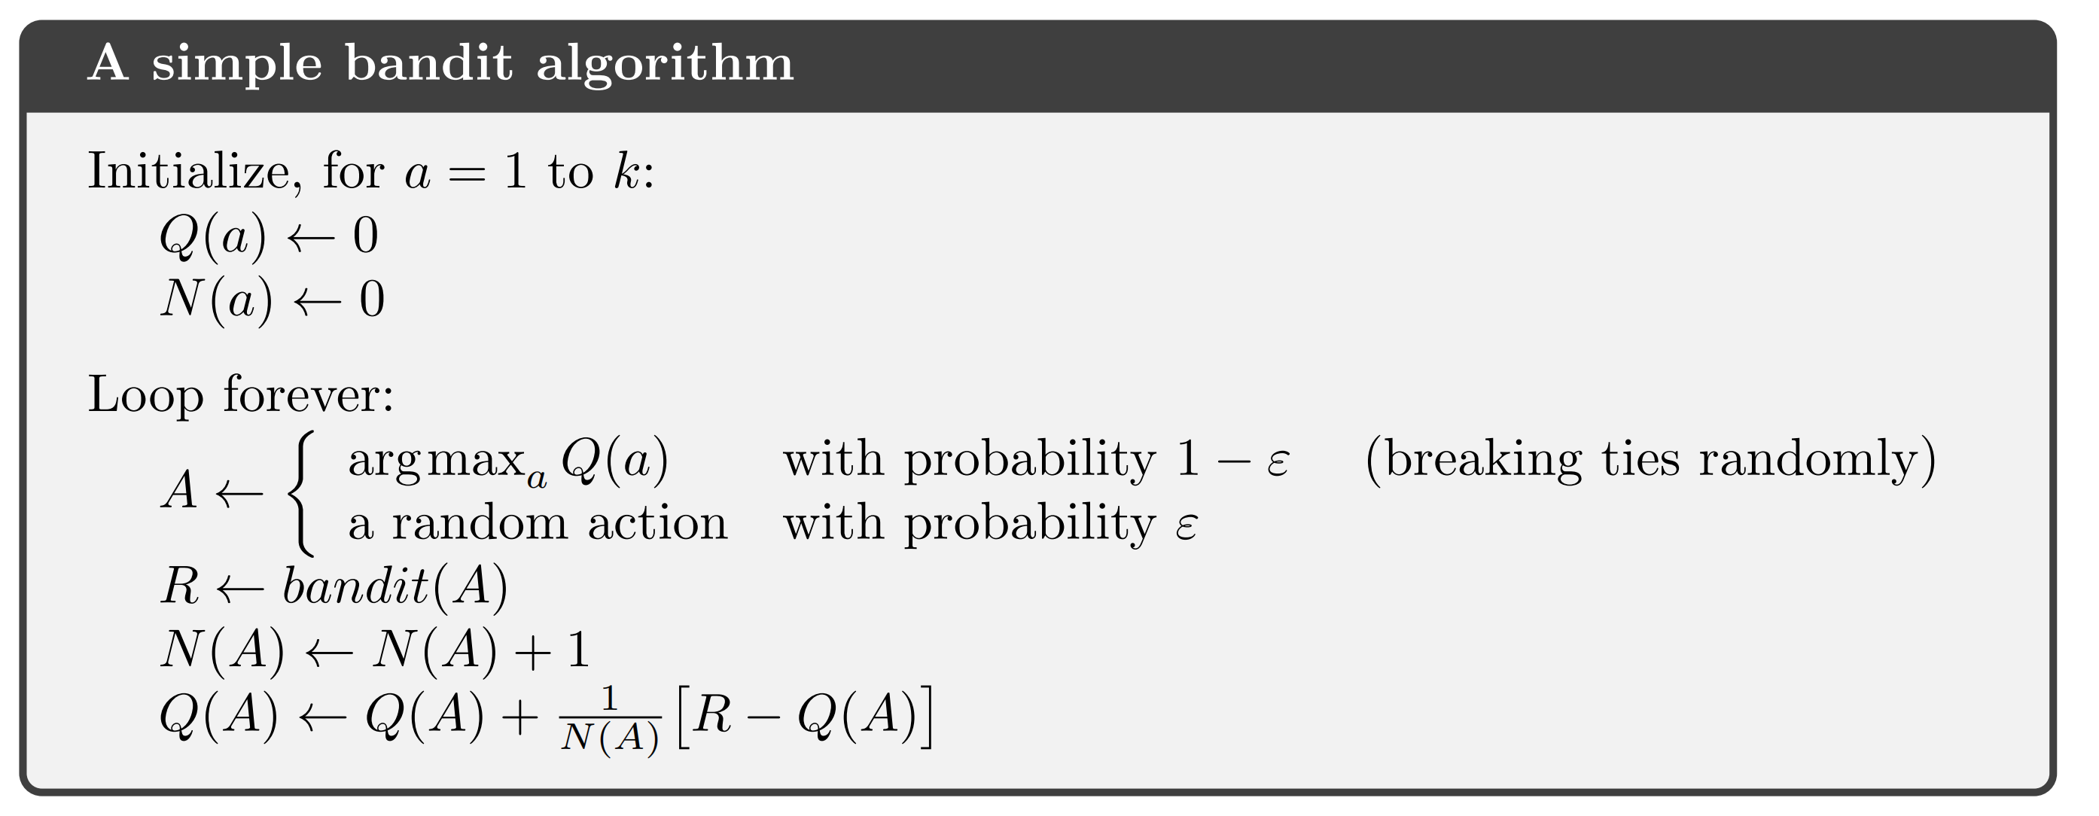
K-Armed Bandit Problem

Slide 12
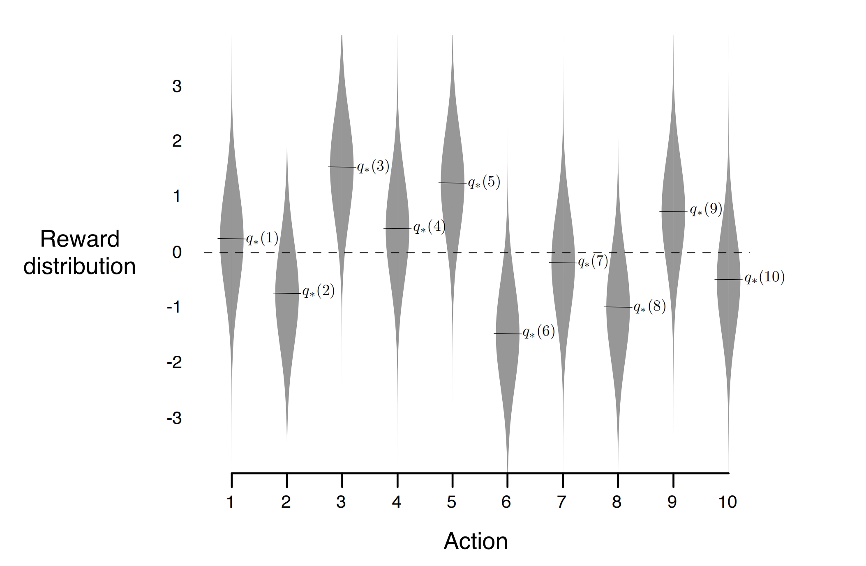
The 10-armed Testbed

Slide 13
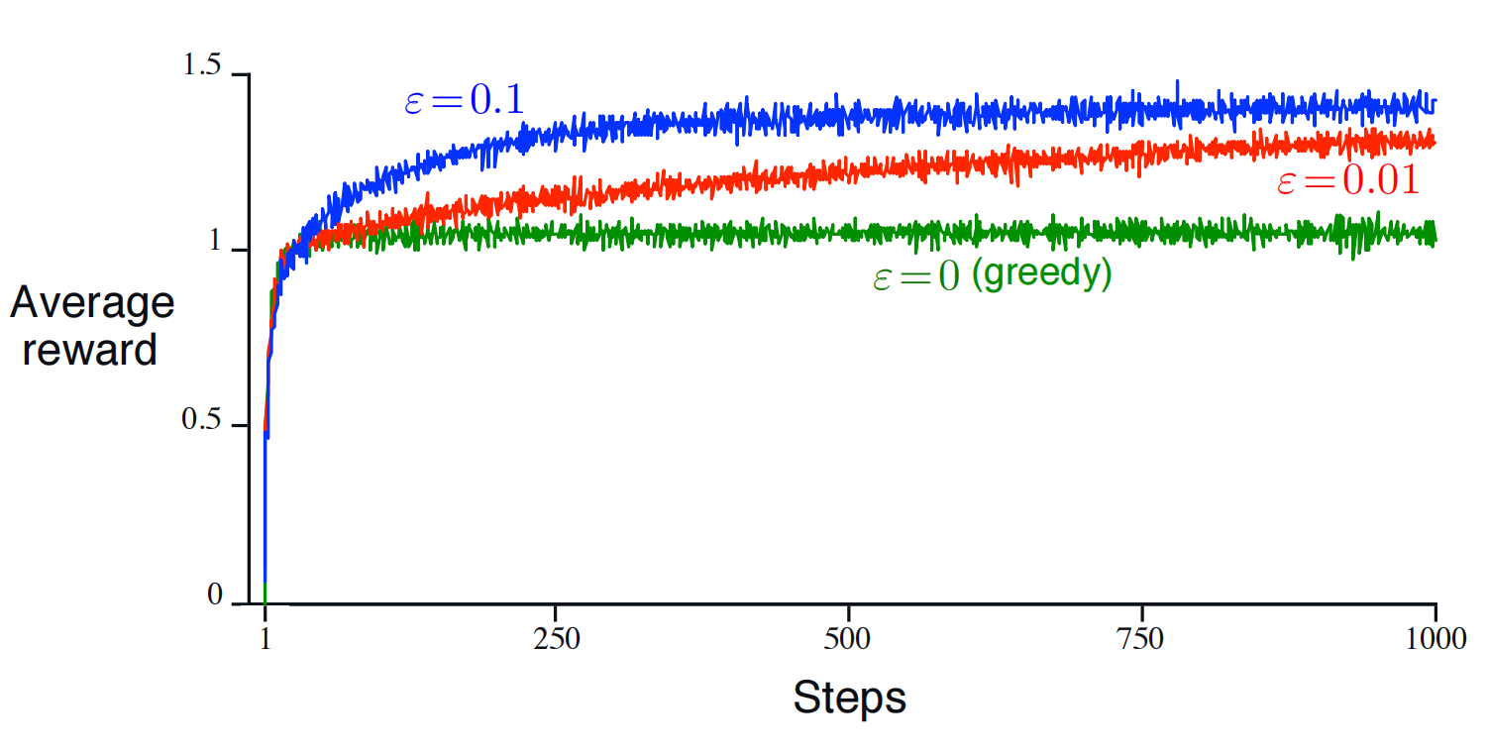
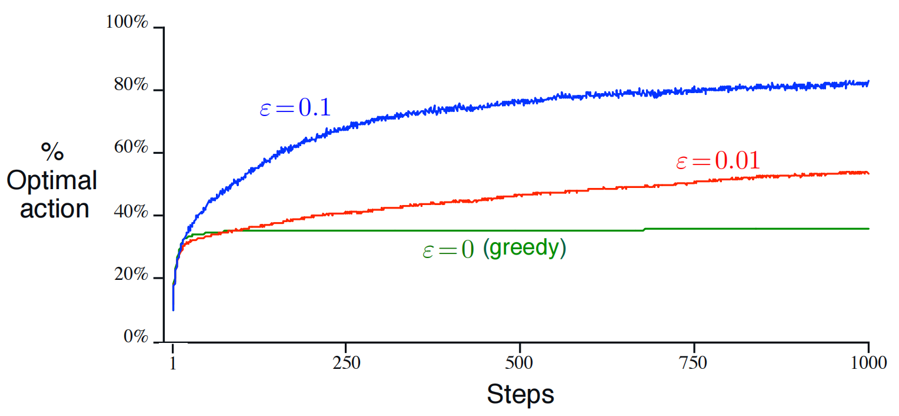
The 10-armed Testbed

Slide 14
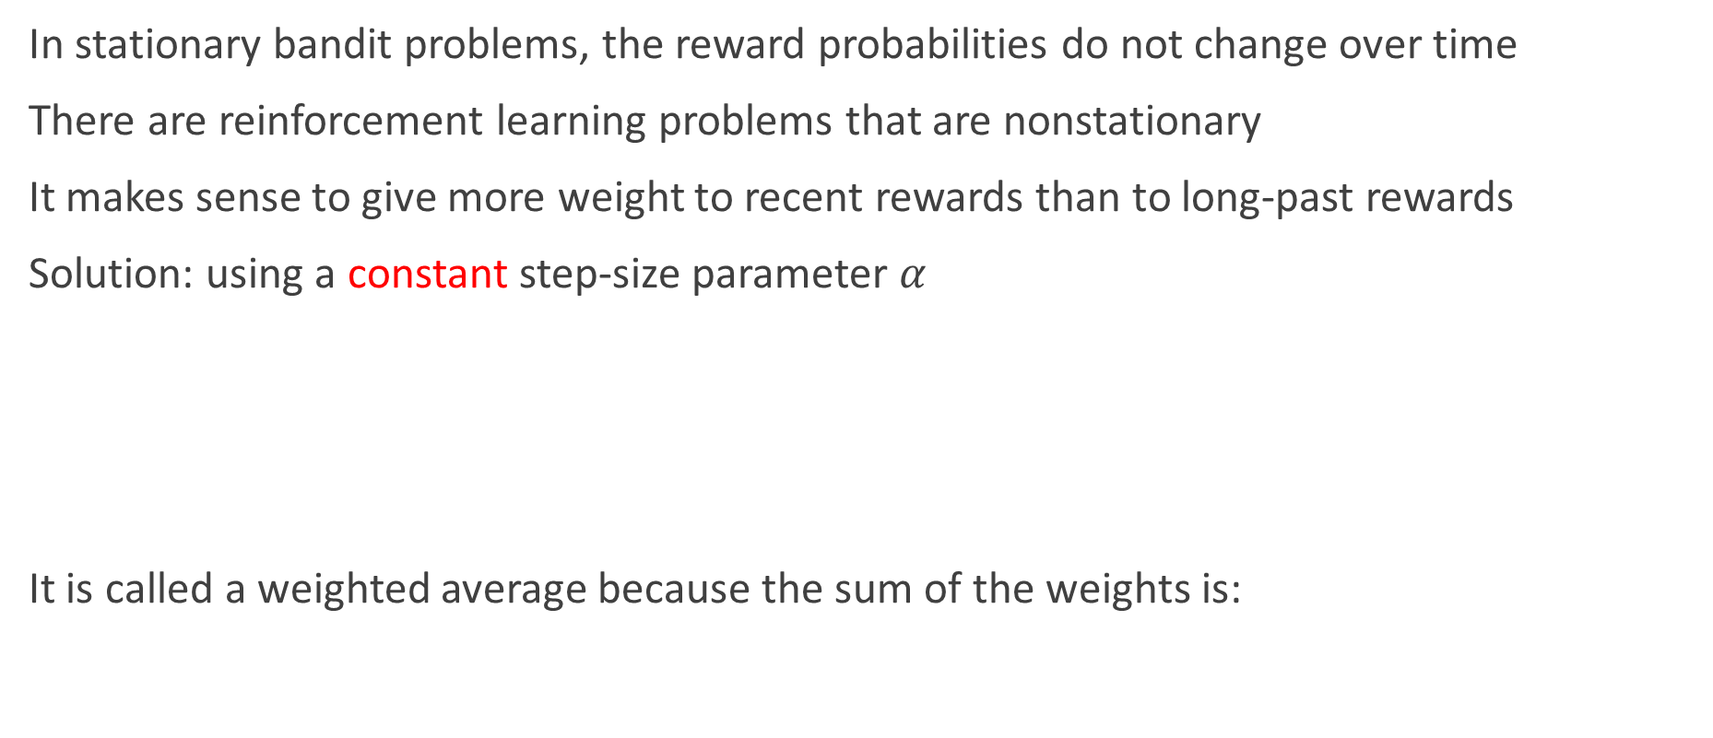
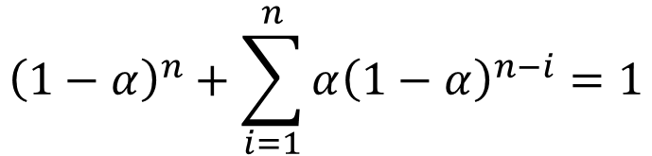
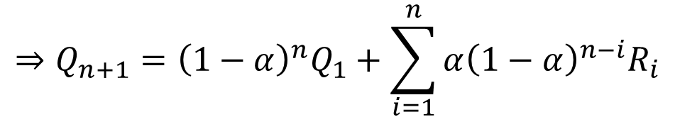
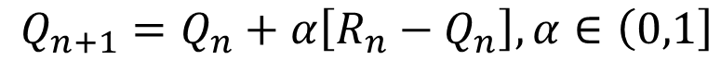
The nonstationary problem
In stationary bandit problems, the reward probabilities do not change over time
There are reinforcement learning problems that are nonstationary
It makes sense to give more weight to recent rewards than to long-past rewards
Solution: using a constant step-size parameter $α$
It is called a weighted average because the sum of the weights is:
$$Q_{n+1}=Q_{n}+α\left[R_{n}−Q_{n}\right],α∈\left(0,1\right]$$
$$⇒Q_{n+1}={\left(1−α\right)}^{n}Q_{1}+\sum_{i=1}^{n}{α{\left(1−α\right)}^{n−i}R_{i}}$$
$${\left(1−α\right)}^{n}+\sum_{i=1}^{n}{α{\left(1−α\right)}^{n−i}}=1$$

Slide 15
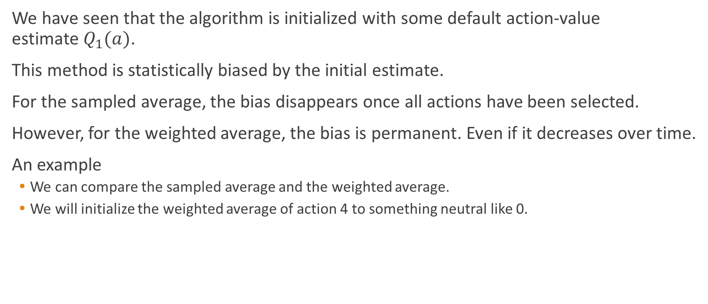
Action-value initialization
We have seen that the algorithm is initialized with some default action-value estimate $Q_{1}(a)$.
This method is statistically biased by the initial estimate.
For the sampled average, the bias disappears once all actions have been selected.
However, for the weighted average, the bias is permanent. Even if it decreases over time.
An example
We can compare the sampled average and the weighted average.
We will initialize the weighted average of action 4 to something neutral like 0.

Slide 16
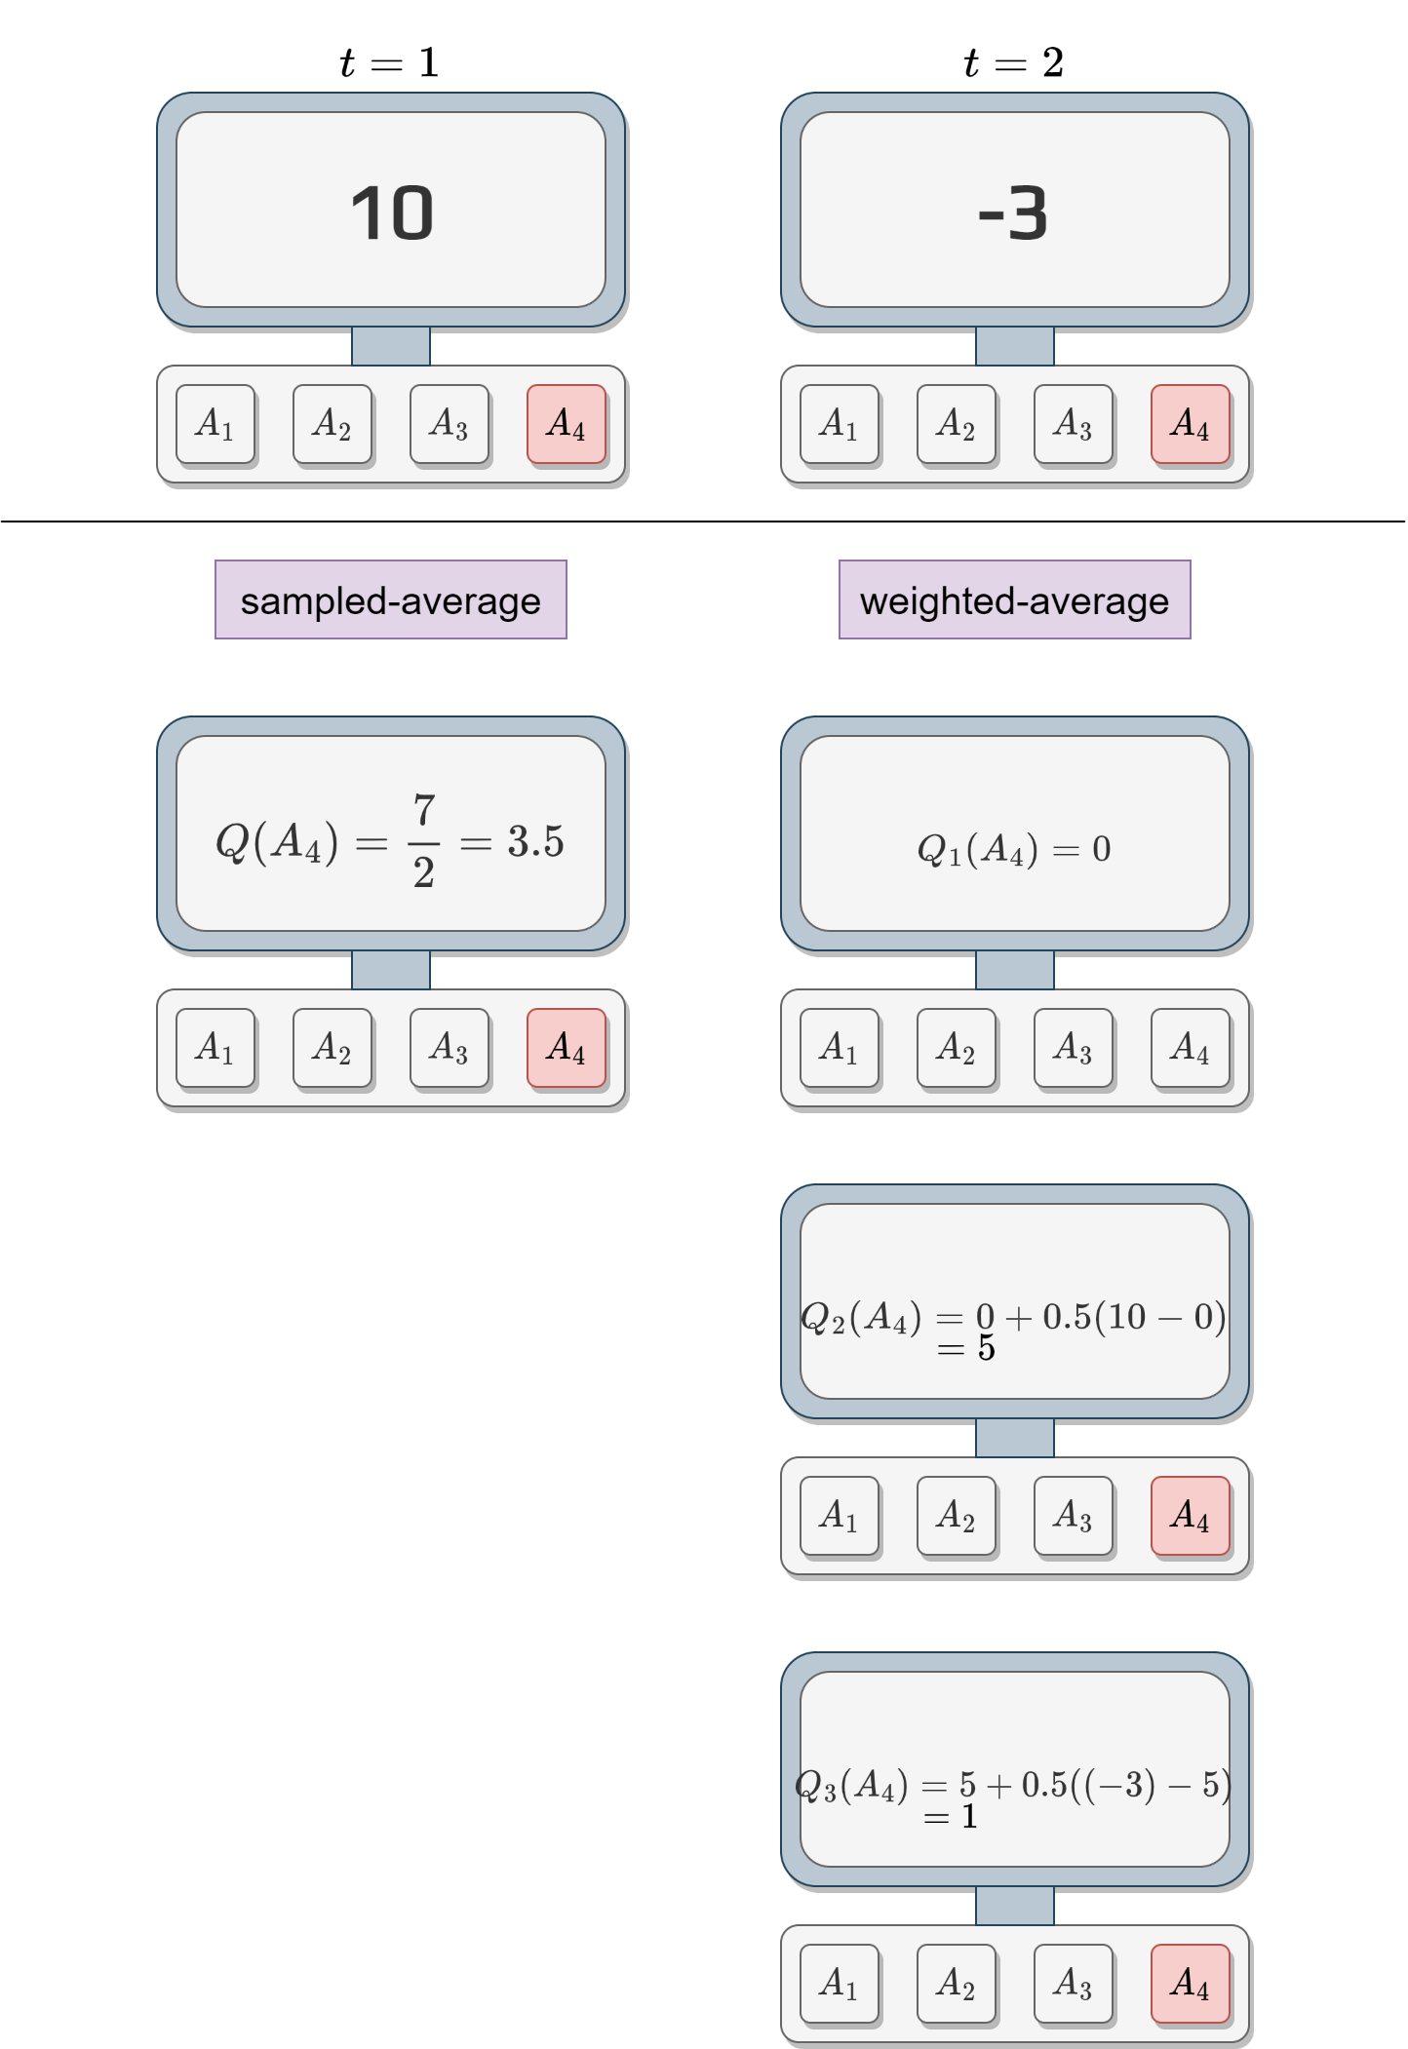

Action-value initialization

Slide 17
Action-value initialization
This bias cannot be overcome by choosing different initial value.
Setting all the actions to a positive value is optimistic.
After trying one action:
The algorithm will be disappointed by the returned reward (compared to the estimate).
It will select another action due to this disappointment.
Because all the actions are over optimistic, the algorithm will choose all of them multiple times.

Slide 18
Upper-Confidence-Bound action-selection
Greedy action-selection:
Always choose the action that has the higher expected reward.
It doesn’t explore.
𝜖-greedy action-selection:
It forces the selection of non-greedy action based on a probability 𝜖.
No preferences between non-greedy action.
It is possible to improve the action-selection by adding a few parameters to the selection algorithm.
The idea is to base the exploration on the uncertainty of the estimate.
Having a high uncertainty means that we didn’t explore the action often compared to the numbers of action selected in total.
If we don’t have a good estimate, we should explore.
We call this Upper-Confidence bound.

Slide 19
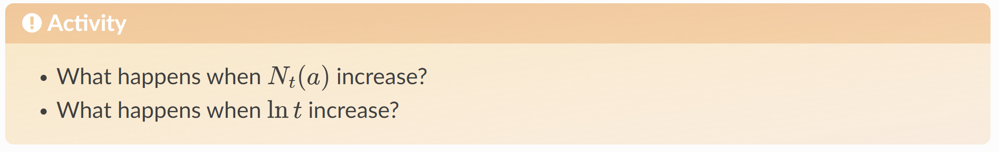
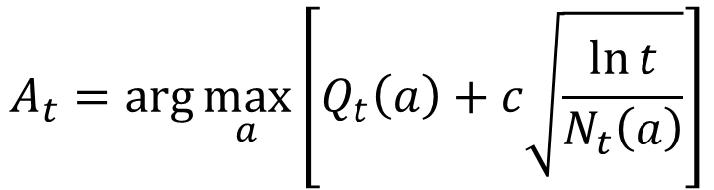
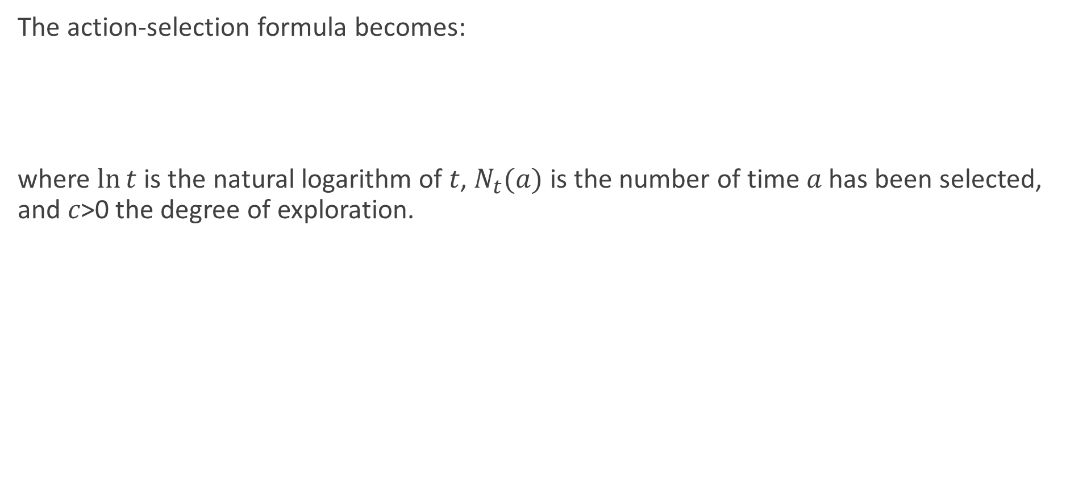
Upper-Confidence-Bound action-selection
The action-selection formula becomes:
where $ln⁡t$ is the natural logarithm of 𝑡, $N_{t}(a)$ is the number of time 𝑎 has been selected, and 𝑐>0 the degree of exploration.
$$A_{t}=\arg{\max_{a}\left[Q_{t}\left(a\right)+c\sqrt{\frac{\ln{t}}{N_{t}\left(a\right)}}\right]}$$

Slide 20
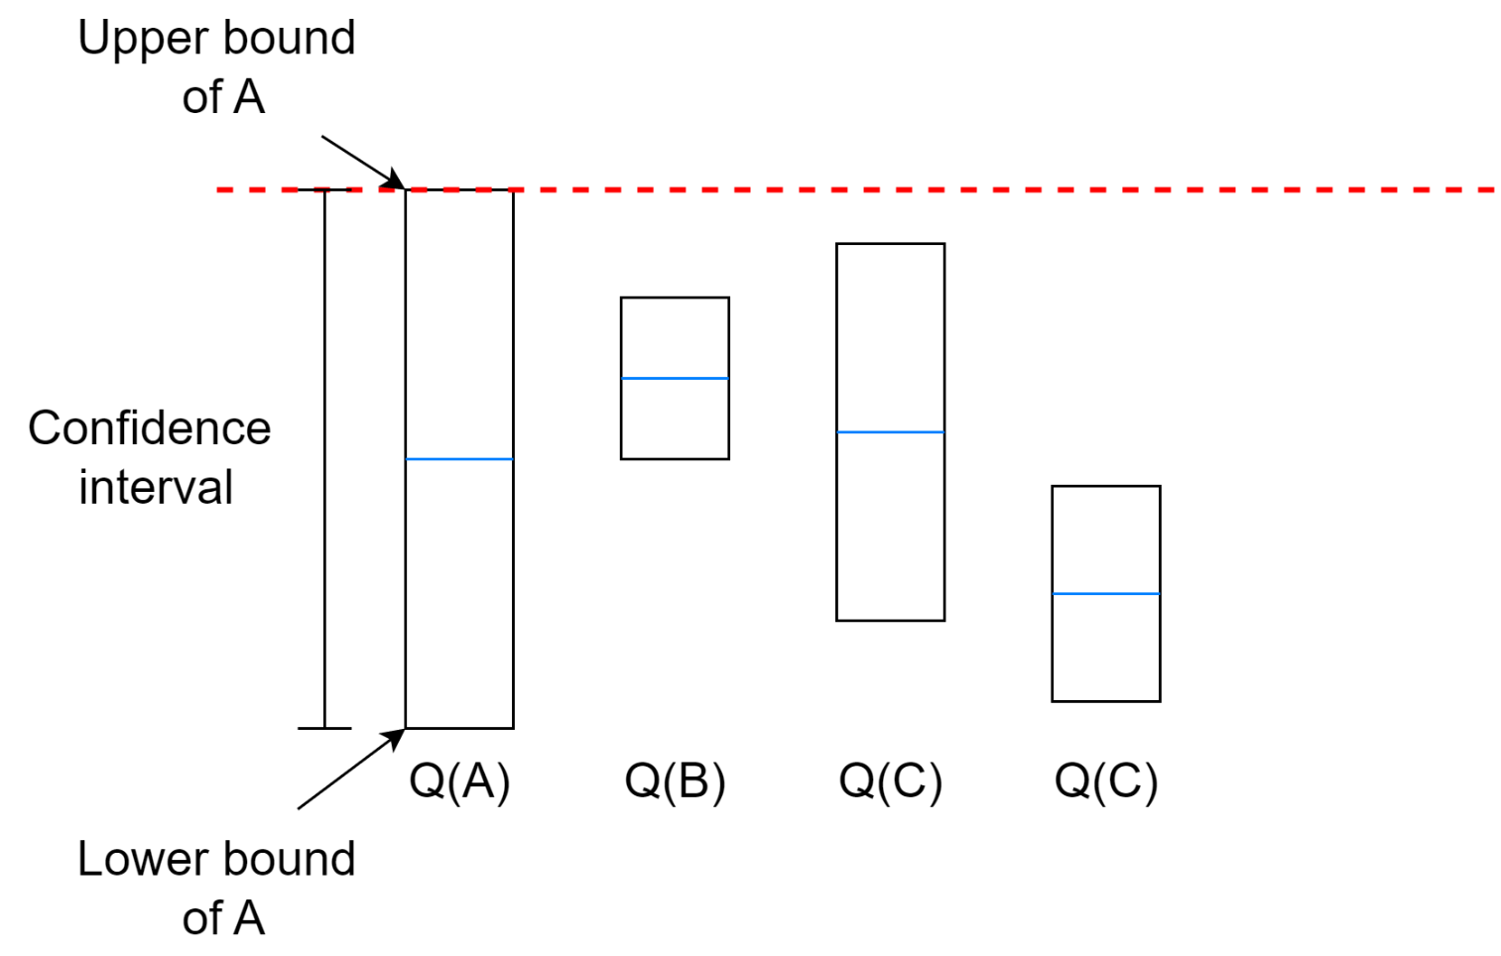
Upper-Confidence-Bound action-selection
When our uncertainty on the estimate decrease the action is less selected
The algorithm will select the action with the highest upper bound even if the uncertainty is very high.
If multiple actions have very close upper bounds, it will depend on the exploration coefficient.

Slide 21

Upper-Confidence-Bound action-selection
Exercise:
If we use our previous samples.
Calculate each 𝑄 values using the weighted average.
Use UCB with 𝑐=2 to decide what will be the next action.

Slide 22
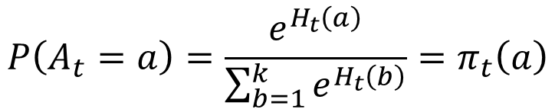
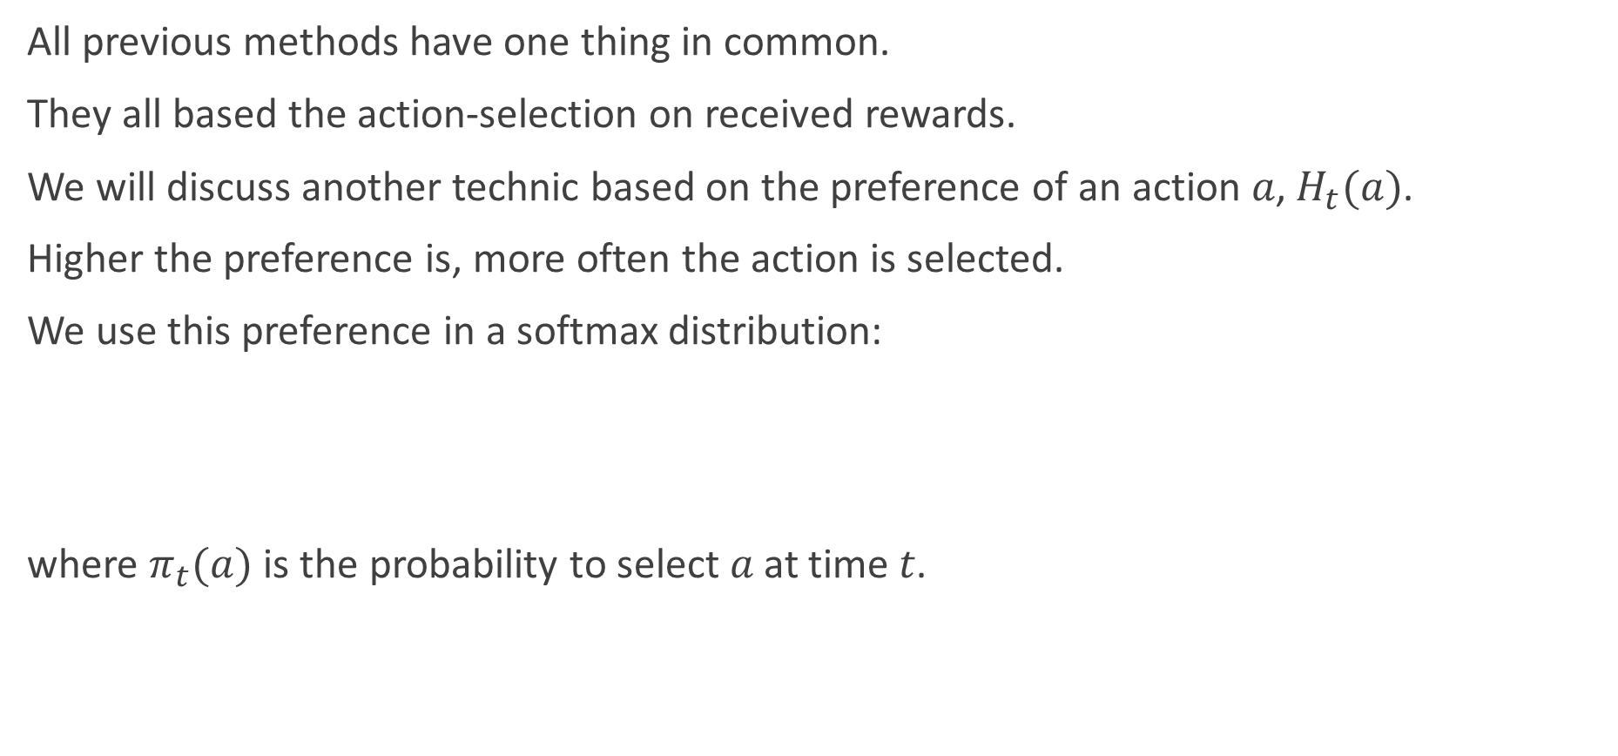
Gradient Bandit Algorithms
All previous methods have one thing in common.
They all based the action-selection on received rewards.
We will discuss another technic based on the preference of an action 𝑎, $H_{t}(a)$.
Higher the preference is, more often the action is selected.
We use this preference in a softmax distribution:
where $π_{t}(a)$ is the probability to select 𝑎 at time 𝑡.
$$P\left(A_{t}=a\right)=\frac{e^{H_{t}\left(a\right)}}{\sum_{b=1}^{k}{e^{H_{t}\left(b\right)}}}=π_{t}\left(a\right)$$

Slide 23
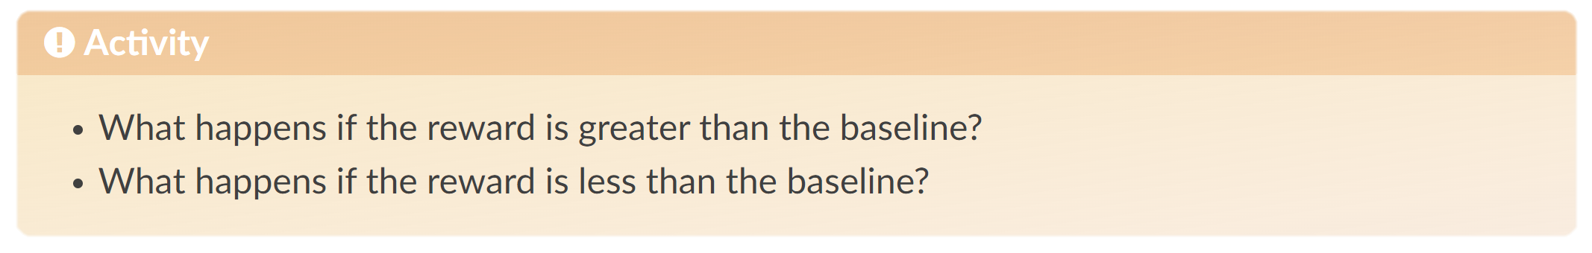
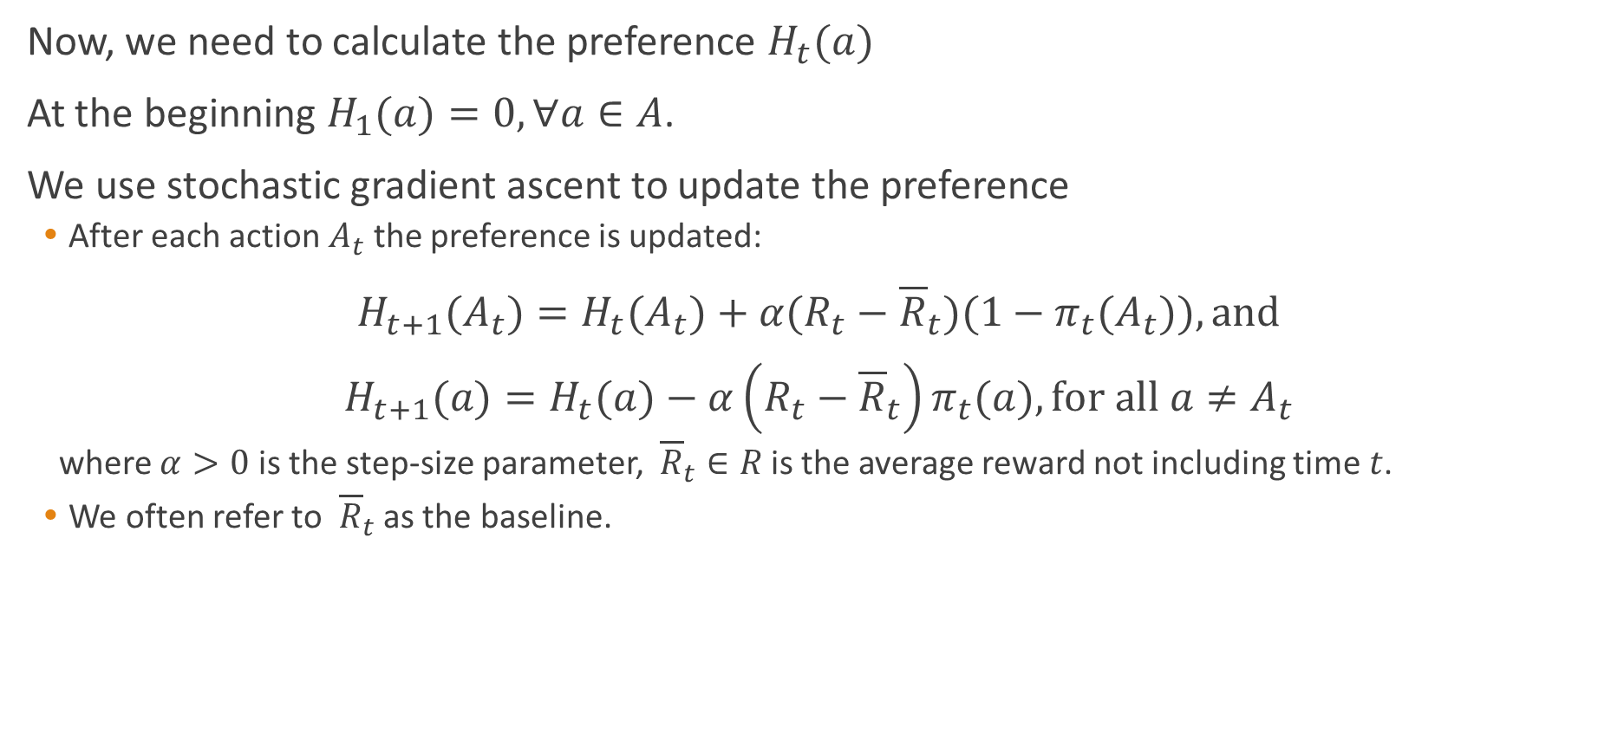
Gradient Bandit Algorithms
Now, we need to calculate the preference $H_{t}(a)$
At the beginning $H_{1}(a)=0,∀a∈A$.
We use stochastic gradient ascent to update the preference
After each action $A_{t}$ the preference is updated:
$H_{t+1}(A_{t})=H_{t}(A_{t})+α(R_{t}−{\overline{R}}_{t})(1−π_{t}(A_{t})), \text{and}$
$H_{t+1}(a)=H_{t}(a)−α\left(R_{t}−{\overline{R}}_{t}\right)π_{t}(a), \text{for} all a≠A_{t}$
where $α>0$ is the step-size parameter, ${\overline{R}}_{t}∈R$ is the average reward not including time 𝑡.
We often refer to ${\overline{R}}_{t}$ as the baseline.
Notes:
If the reward is higher than the baseline, then the probability of taking At in the future is increased, and if the reward is below baseline, then the probability is decreased. The non-selected actions move in the opposite direction.

Slide 24
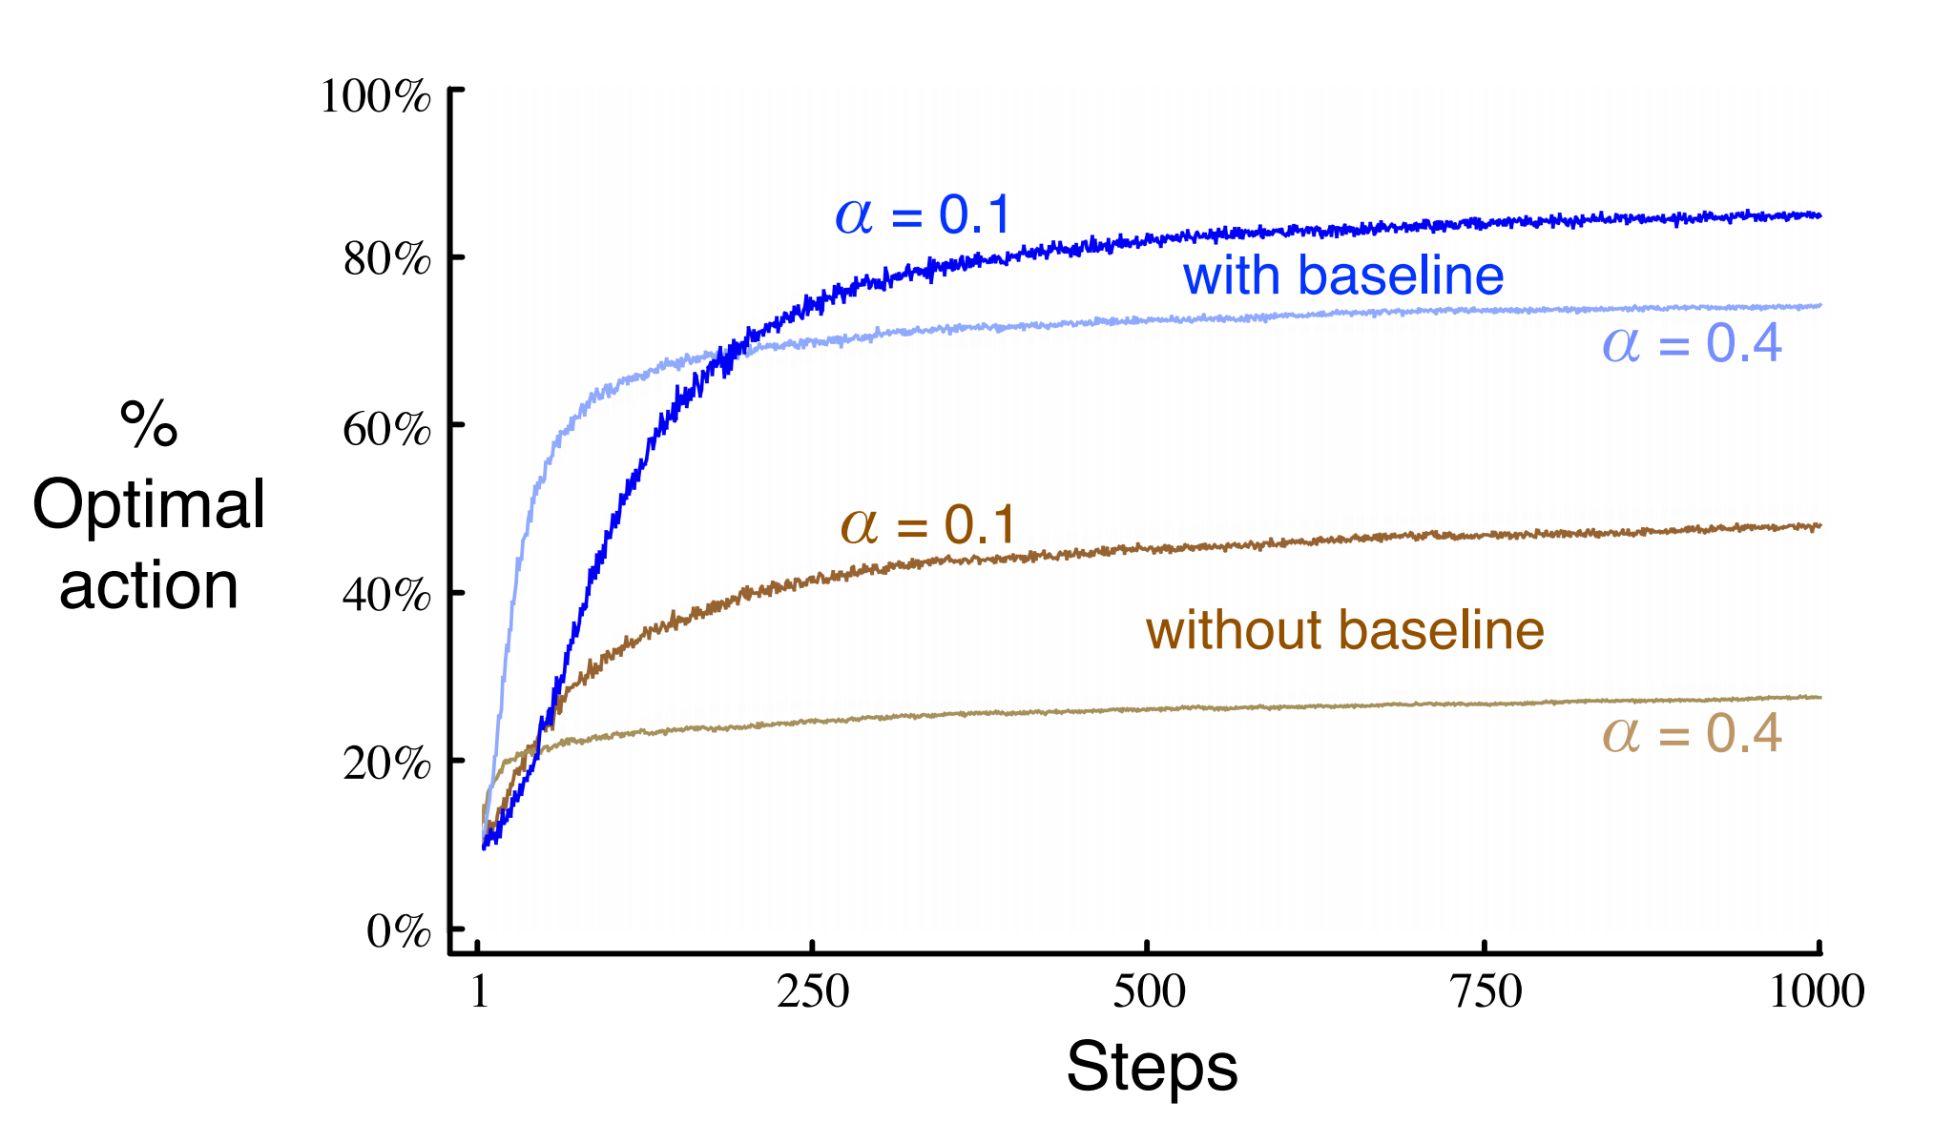
Gradient Bandit Algorithms
Notes:
Average performance of the gradient bandit algorithm with and without a reward baseline on the 10-armed testbed when the q*(a) are chosen to be near +4 rather than near zero

Slide 25
Finite Markov Decision Process
Reinforcement Learning has its foundation in the formal problem of Markov Decision Process (MDP).
Markov Decision Process is a mathematical model formalizing sequential decision-making.
Problems in which we take multiple consecutive actions.
Actions have consequences on the future states and future rewards.

Slide 26
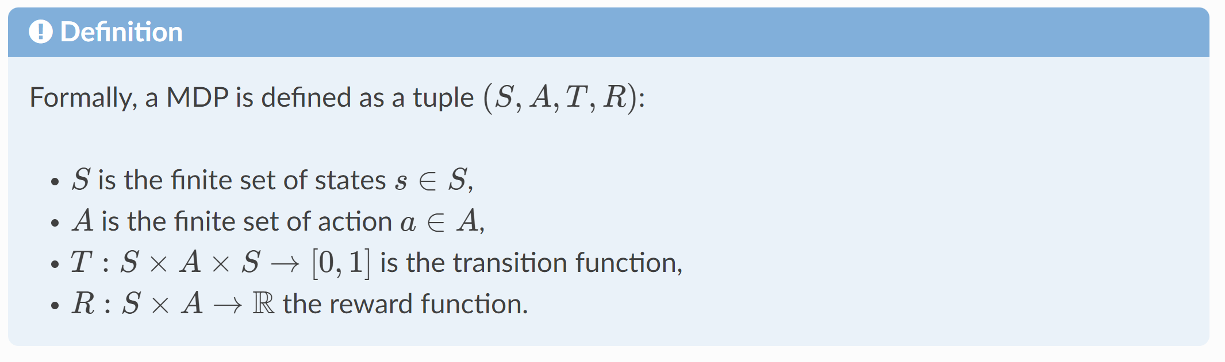
Markov Decision Process Definition
Markov decision processes formalize how an agent learn to achieve a goal.
The agent can interact with the environment.
The environment comprises everything outside the agent.
When the agent interact with the environment, the environment changes.
The agent will then consider a possible new action depending of the new situation.
It repeats until the problem is solved.
Notes:
S A R are finite sets

Slide 27
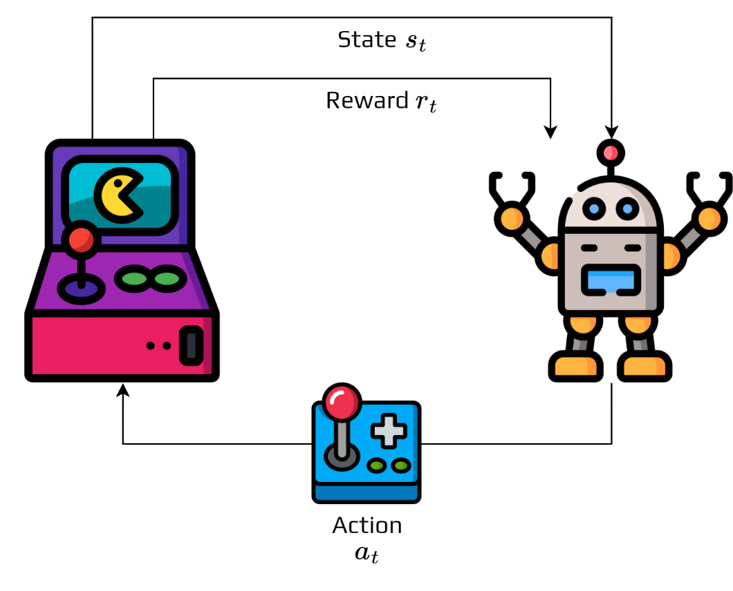
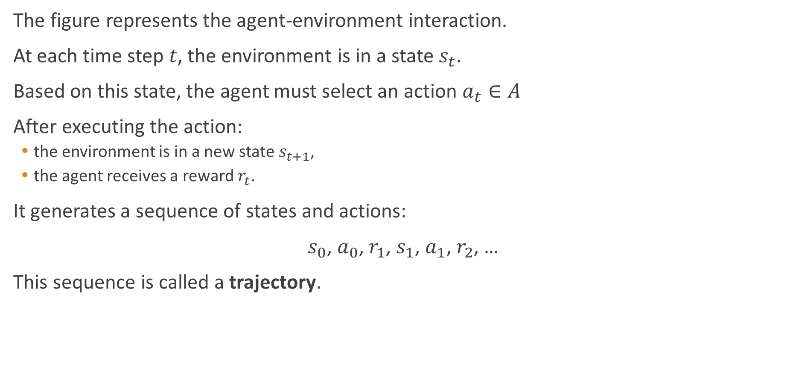
Markov Decision Process Definition
The figure represents the agent-environment interaction.
At each time step 𝑡, the environment is in a state $s_{t}$.
Based on this state, the agent must select an action $a_{t}∈A$
After executing the action:
the environment is in a new state $s_{t+1}$,
the agent receives a reward $r_{t}$.
It generates a sequence of states and actions:
$s_{0}$, $a_{0}$, $r_{1}$, $s_{1}$, $a_{1}$, $r_{2}$, …
This sequence is called a trajectory.

Slide 28
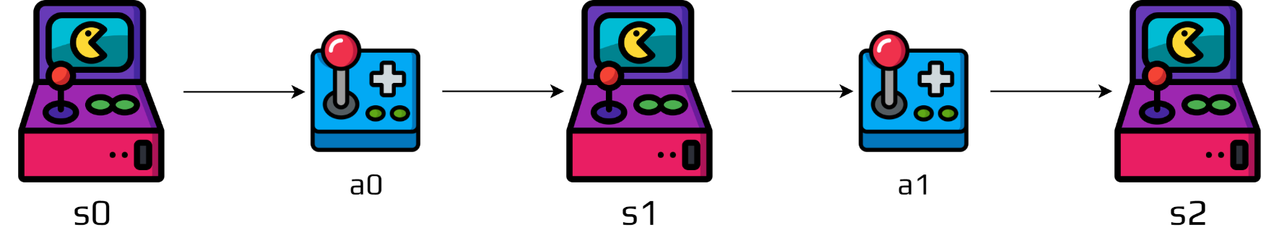
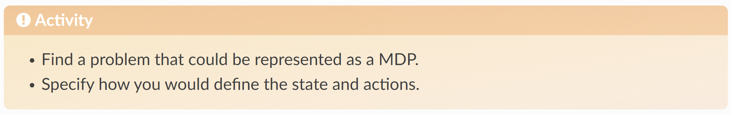
Markov Decision Process Definition

Slide 29
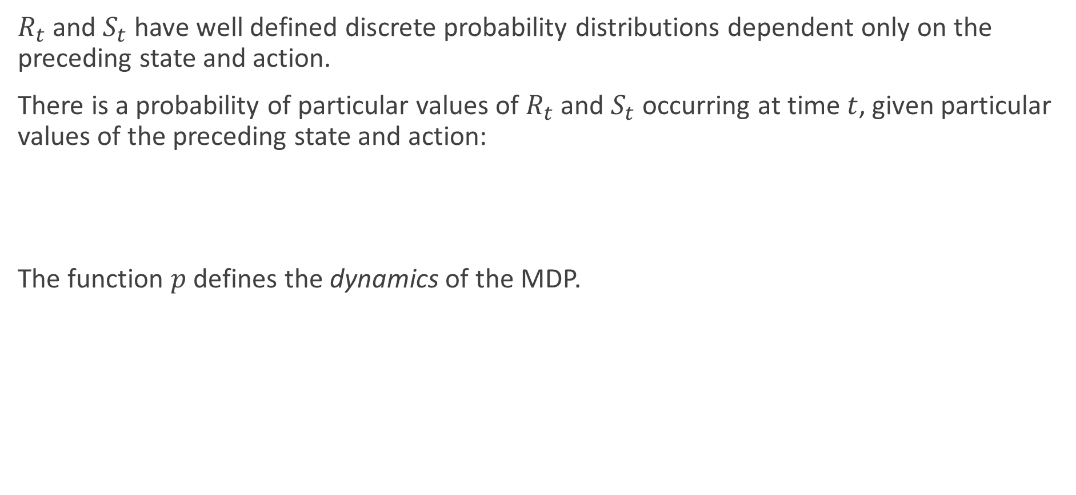
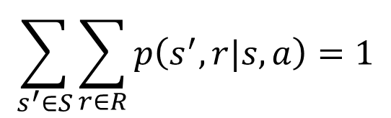
Transition function
$R_{t}$ and $S_{t}$ have well defined discrete probability distributions dependent only on the preceding state and action.
There is a probability of particular values of $R_{t}$ and $S_{t}$occurring at time $t$, given particular values of the preceding state and action:
The function $p$ defines the dynamics of the MDP.
$$p\left(s^{′},r|s,a\right)≜\operatorname{Pr}\left\{s_{t}=s^{′},r_{t}=r | s_{t−1}=s,a_{t−1}=a\right\},\text{for} \text{all} s^{′},s∈S \text{and} a∈A$$
$$\sum_{s^{′}∈S}{\sum_{r∈R}{p\left(s^{′},r|s,a\right)}}=1$$

Slide 30
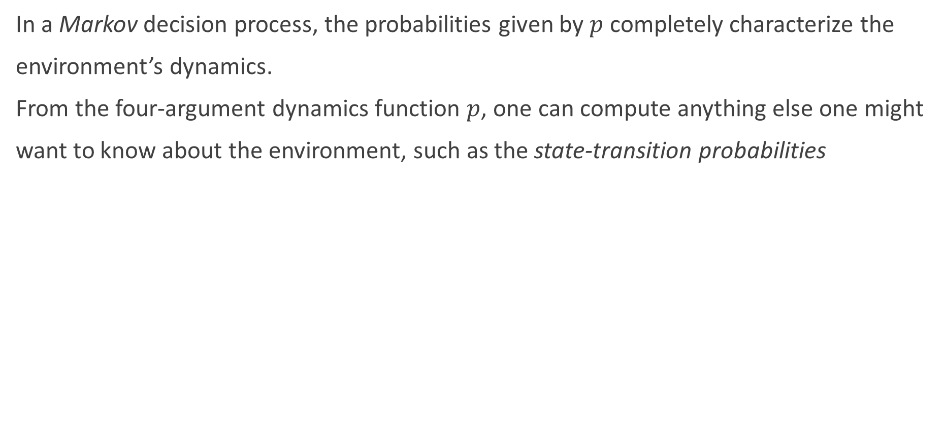
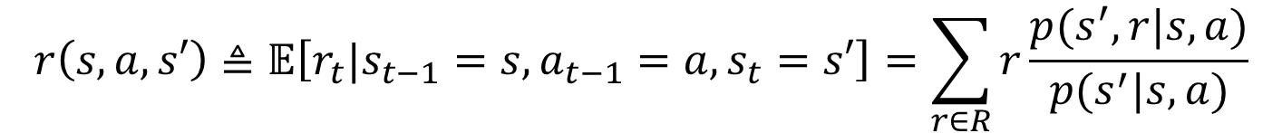
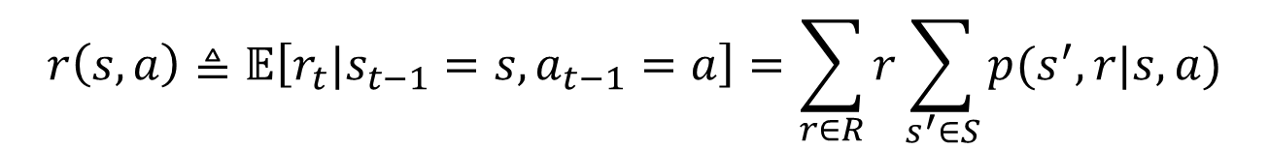
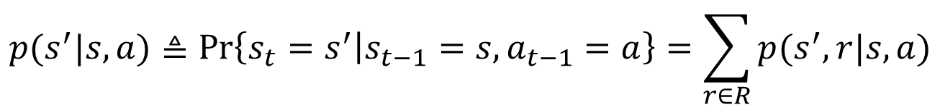
Transition function
In a Markov decision process, the probabilities given by $p$ completely characterize the
environment’s dynamics.
From the four-argument dynamics function $p$, one can compute anything else one might
want to know about the environment, such as the state-transition probabilities
$$p(s^{′}|s,a)≜\operatorname{Pr}\left\{s_{t}=s^{′} | s_{t−1}=s,a_{t−1}=a\right\}=\sum_{r∈R}{p(s^{′},r|s,a)}$$
$$r\left(s,a\right)≜𝔼\left[r_{t}|s_{t−1}=s,a_{t−1}=a\right]=\sum_{r∈R}{r\sum_{s^{′}∈S}{p(s^{′},r|s,a)}}$$
$$r\left(s,a,s′\right)≜𝔼\left[r_{t}|s_{t−1}=s,a_{t−1}=a,s_{t}=s′\right]=\sum_{r∈R}{r\frac{p(s^{′},r|s,a)}{p(s^{′}|s,a)}}$$
Notes:
the probability of each possible value for St and Rt depends on the immediately preceding state and action, St−1 and At−1, and, given them, not at all on earlier states and actions. This is best viewed as a restriction not on the decision process, but on the state. The state must include information about all aspects of the past agent–environment interaction that make a difference for the future. If it does, then the state is said to have the Markov property.

Slide 31
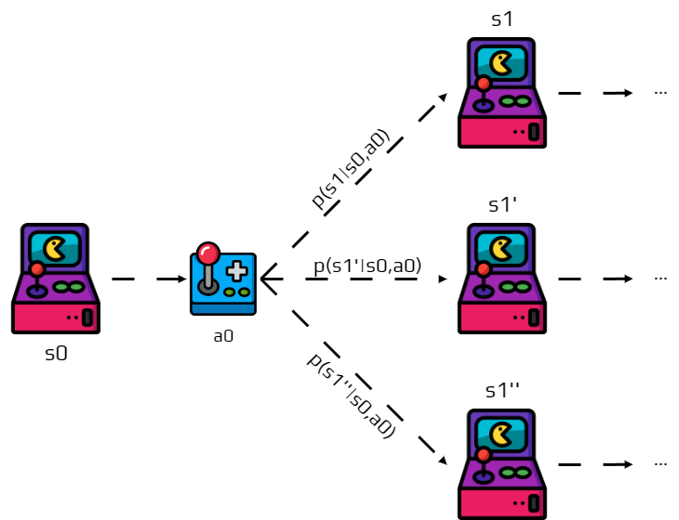
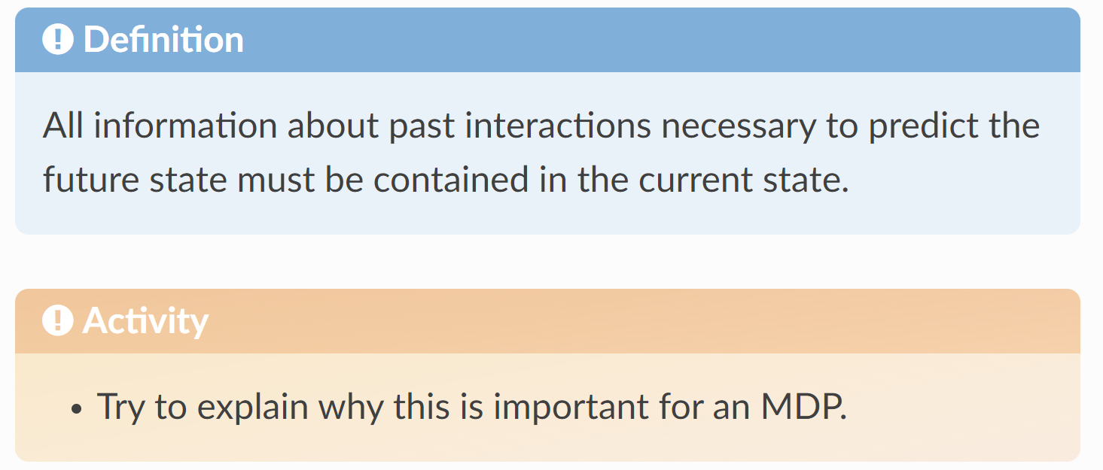
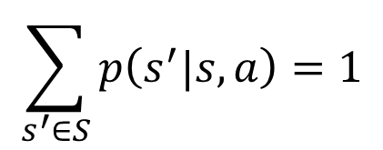
Transition function
The probability of 𝑠′ depends only on state 𝑠 and action 𝑎.
We call this the Markov property.
$$\sum_{s^{′}∈S}{p\left(s^{′}|s,a\right)}=1$$
Notes:
The general rule we follow is that anything that cannot be changed arbitrarily by the agent is considered to be outside of it and thus part of its environment. The agent–environment boundary represents the limit of the agent’s absolute control, not of its knowledge.
The MDP framework is a considerable abstraction of the problem of goal-directed learning from interaction. Any problem of learning goal-directed behavior can be reduced to three signals passing back and forth between an agent and its environment: one signal to represent the choices made by the agent (the actions), one signal to represent the basis on which the choices are made (the states), and one signal to define the agent’s goal (the rewards).

Slide 32
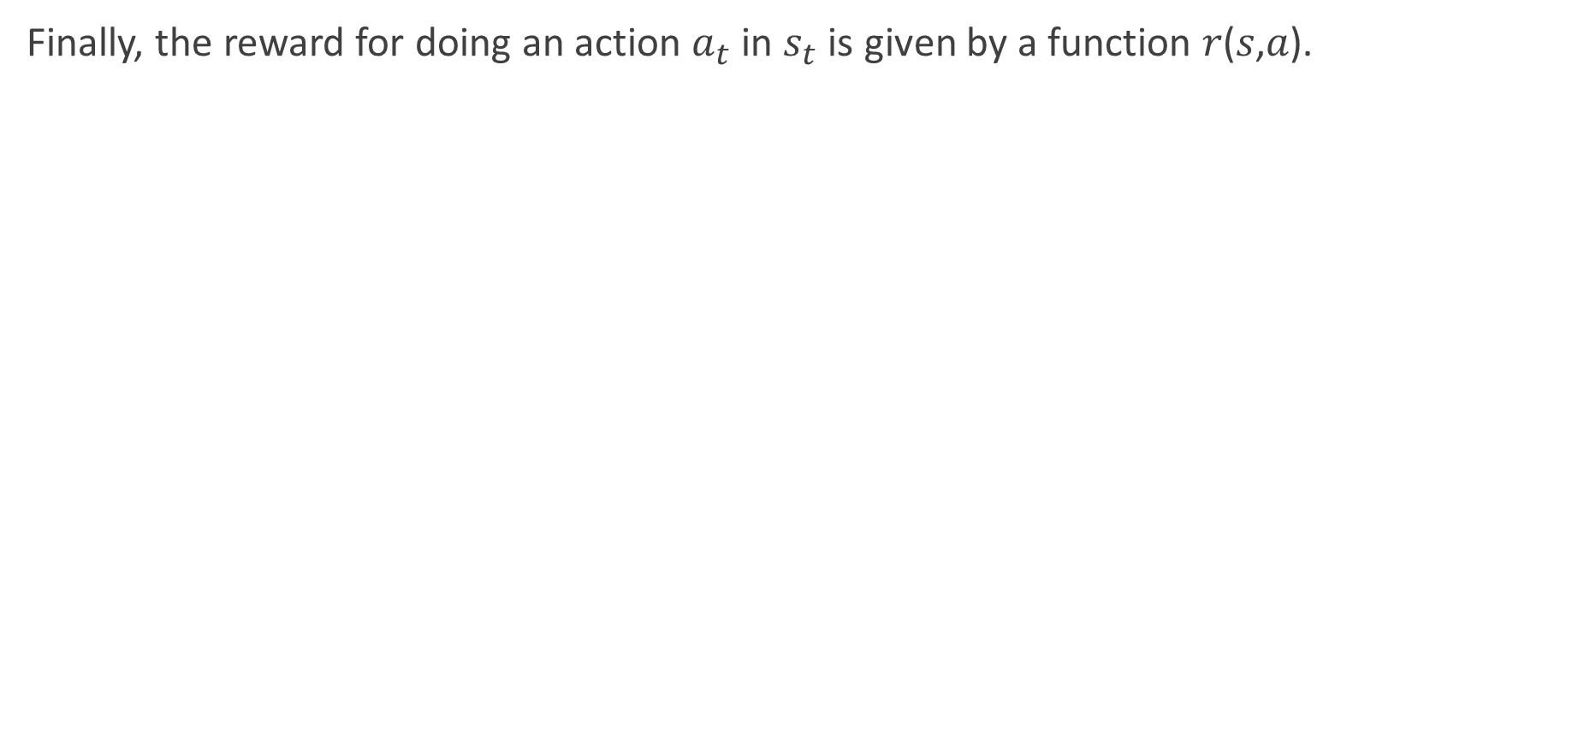
Reward function
Finally, the reward for doing an action $a_{t}$ in $s_{t}$ is given by a function 𝑟(𝑠,𝑎).

Slide 33
Applications and implications
This framework is popular, because it’s abstract and flexible.
You can model lot of different problems with a single framework.
Algorithms to solve it can be reused for any problems if modelled as a MDP.
Actions:
Low-level actions: Voltage input for robots’ actuators (wheels, arms, etc.).
High-level actions: Direction where the robot needs to move (Up, Down, Right, Left).
Time steps:
In real time: a time interval between actions.
Abstract: Player turn.
State representation:
The state can be very low level. For example, the sensor reading from a robot.
Something high-level like the position in the maze.
Or totally abstract, like the agent being in a state of not knowing if it’s raining outside.
Notes:
This is why you can find RL in different fields:
Robotics
Economics
NLP
IoT

Slide 34
Defining goals and rewards
We use RL for something, usually we want to solve a problem.
To solve a problem you have an objective, a goal.
In reinforcement learning (and MDP) the goal is not directly defined.
You can verify in the MDP definition, the goal is mentioned nowhere.
Instead of defining the goal directly, we use the reward function to do it.
After each action 𝑎, the environment send to the agent a reward 𝑟∈𝑅.
So the goal for the agent is to maximize the long term cumulated reward.
Consequently, you need to design a reward function that leads to the concrete goal.
It can seem limiting, but it’s very flexible in practice.

Slide 35
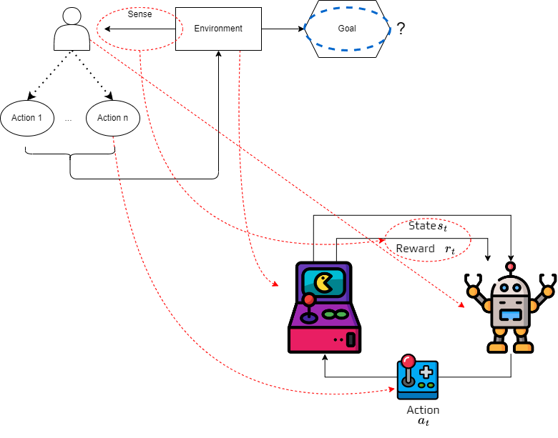
Defining goals and rewards

Slide 36
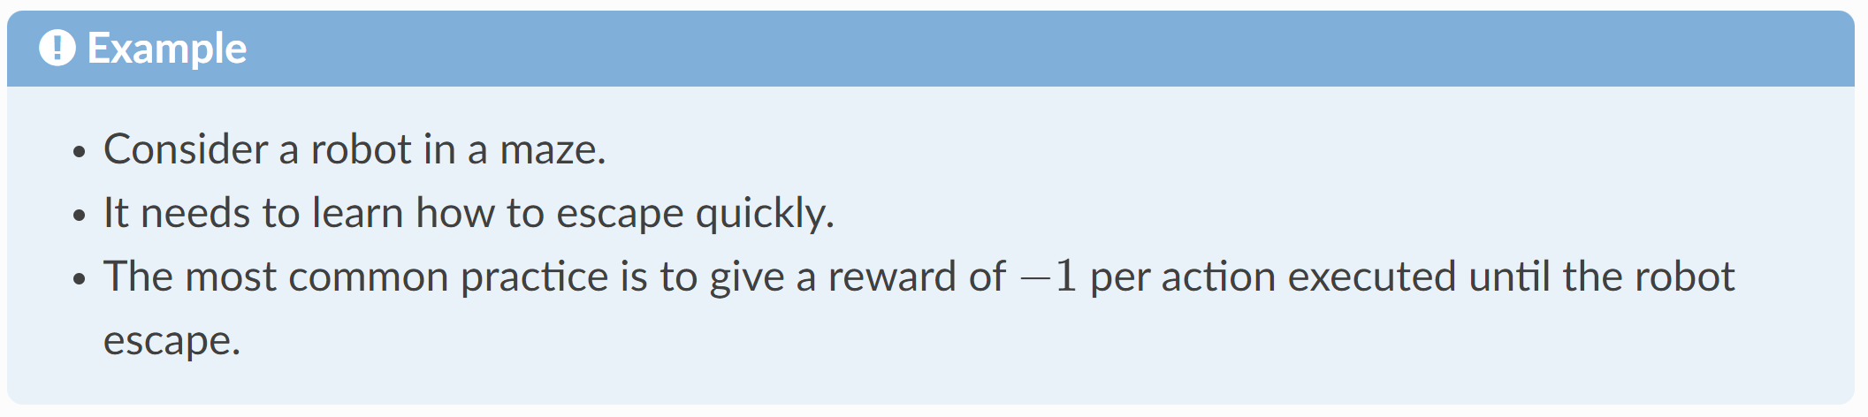

Defining goals and rewards
The agent will maximize the cumulated reward, so we must provide a reward function that if maximized lead to the goal we want.

Slide 37

Defining goals and rewards

Slide 38


Cumulative rewards
Remember that after few times steps we obtain a trajectory:
Similarly we also obtain a sequence of rewards associated to this trajectory:
Notes:
In the previous topic, we introduced formally Markov Decision Processes.
The objectives of MDP is to maximize the cumulative reward.
We will see how it can be done and how it is linked to the action selection.

Slide 39

Cumulative rewards
As the objective is to maximize the cumulative rewards, we need to consider which part of this sequence we want to maximize.
Remember that for a same action in a same state the next future state is not certain, so it complicates things.

Slide 40

Cumulative rewards
This is why, in reinforcement learning we try to maximize the expected return.
The return is denoted 𝐺𝑡 and can be defined as the sum of the rewards:
$G_{t}=r_{t},r_{t+1},…,r_{T}$
where 𝑇 is the final step.
As you can see it is very well defined when 𝑇 has a maximum value.

Slide 41

Cumulative rewards

Slide 42

Cumulative rewards
Due to this issue, it was introduced the notion of discounted return:
$G_{t}=r_{t}+γr_{t+1}+γ^{2}r_{t+2}=\sum_{k=0}^{∞}{γ^{k}r_{t+k}}$
where $γ$ is a parameter $0≤γ≤1$ called discount rate.
This discount rate represents how much future rewards are important compared to immediate rewards.
A reward received at step 𝑘 is worth only 𝛾𝑘 times what it would be worth now.
If 𝛾=0 the agent only consider immediate reward, thus is greedy.
When 𝛾 approaches 1, the agent becomes farsighted.

Slide 43

Cumulative rewards

Slide 44




Cumulative rewards
This is crucial part of reinforcement learning.
It works well, because the returns at each time step are related to each other:
Even if $T=∞$ the return is still finite
if the reward is nonzero and constant and,
if $γ<1$
For example, is the reward is a constant +1, then the return is:
$$G_{t}=r_{t}+γr_{t+1}+γ^{2}r_{t+2}+…$$
$$=r_{t}+γ\left(r_{t+1}+γr_{t+2}+…\right)$$
$$=r_{t}+γG_{t+1}$$
$$G_{t}=\sum_{k=0}^{∞}{γ^{k}}=\frac{1}{1−γ}$$

